Slide 1
Centers for Medicare & Medicaid Services: Efforts to Increase Health Care Access and Quality of Care for People with Disabilities
CMS Office of Minority Health
Medicare-Medicaid Coordination Office
October 2020

Slide 2
Agenda
About CMS Office of Minority Health (OMH)
CMS OMH Approach to Achieve Health Equity
CMS OMH Health Equity Work for People with Disabilities
About Medicare-Medicaid Coordination Office
Disability-Competent Care Overview
Health Care Workforce Support for Providing Disability-Competent Care

Slide 3
CMS Office of Minority Health:
Health Equity for People with Disabilities

Slide 4

Karen Gentile, LCSW-C, JD
Leads the portfolio in CMS Office of Minority Health (OMH) that addresses health equity for people with disabilities.
Leads the development of disability technical assistance materials.
Provides disability health equity technical assistance throughout CMS.
Chairs a federal workgroup that addresses health care accessibility for people with disabilities.
Licensed clinical social worker and attorney with over 25 years of professional experience in both disciplines.

Slide 5








Offices of Minority Health at HHS
More info:
minorityhealth.hhs.gov/omh/browse.aspx?lvl=2&lvlid=7

Slide 6
CMS OMH Office of Minority Health
Mission
To ensure that the voices and the needs of the populations we represent (racial and ethnic minorities, sexual and gender minorities, rural populations, and people with disabilities) are present as the Agency is developing, implementing, and evaluating its programs and policies.
Vision
All CMS beneficiaries have achieved their highest level of health, and disparities in health care quality and access have been eliminated.

Slide 7
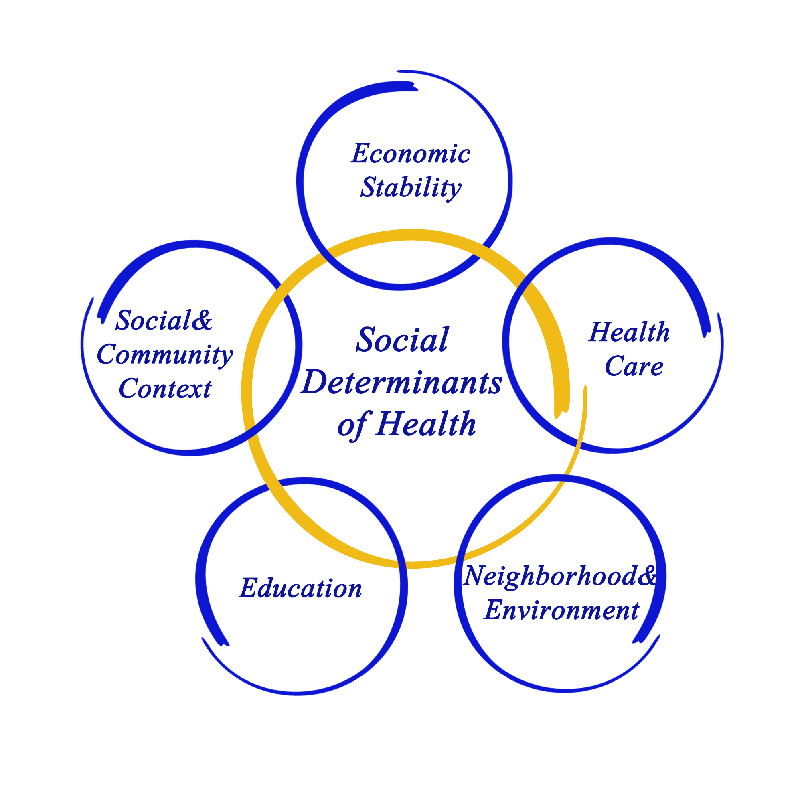
Social Determinants of Health
What are Social Determinants of Health?
Social Determinants of Health (SDOH) are defined by the World Health Organization and the Centers for Disease Control and Prevention as “the conditions in which people are born, grow, live, work and age. These circumstances are shaped by the distribution of money, power, and resources at global, national and local levels.”
Why are SDOH important?
SDOH are important because they impact patient health in unique ways. It’s estimated that between 70-90% of health is determined by SDOH. This doesn’t mean that the clinical encounter doesn’t matter – but instead, that health and health outcomes are influenced by the context of a person’s place and space in society.
Citation:
who.int/social_determinants/sdh_definition

Slide 8
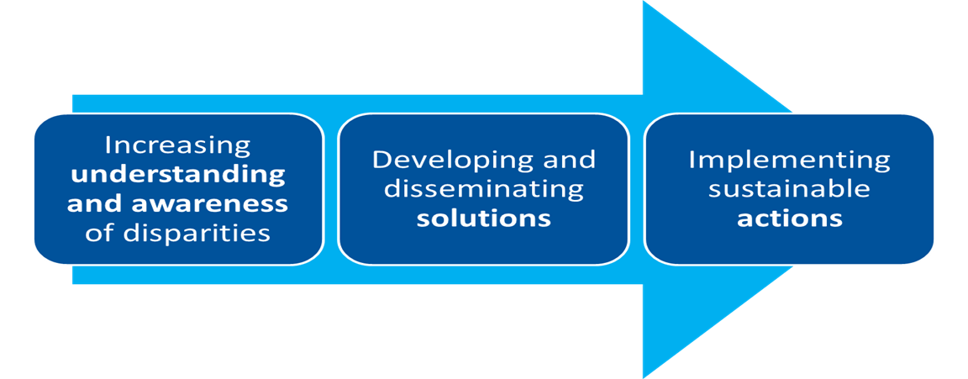
CMS OMH Health Equity Framework
Citation:
cms.gov/About-CMS/Agency-Information/OMH/OMH_Dwnld-CMS_EquityPlanforMedicare_090615.pdf

Slide 9
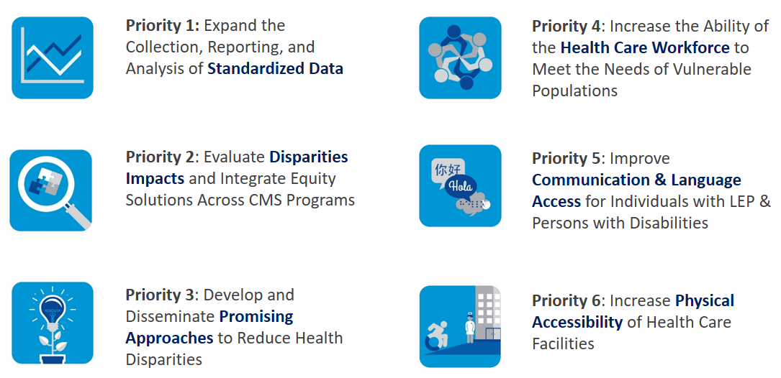
Planning for Equity
More info:
cms.gov/About-CMS/Agency-Information/OMH/equity-initiatives/equity-plan

Slide 10
Increasing Understanding and Awareness of Disparities for People with Disabilities

Slide 11
Incorporating HHS Disability Data Standards into
Health Care Data Collection
In 2011, ASPE released the HHS Implementation Guidance on Data Collection Standards for Race, Ethnicity, Sex, Primary Language, and Disability Status, mandating all population-level surveys administered or sponsored by HHS include items covering these topics.
Data standards included a 6-item disability minimum data set.
  Are you deaf or do you have serious difficulty hearing? Yes/No
  Are you blind or do you have serious difficulty seeing, even when wearing glasses? Yes/No
  Because of a physical, mental, or emotional condition, do you have serious difficulty concentrating, remembering, or making decisions? (5 years old or older) Yes/No
  Do you have serious difficulty walking or climbing stairs? (5 years old or older) Yes/No
  Do you have difficulty dressing or bathing? (5 years old or older) Yes/No
  Because of a physical, mental, or emotional condition, do you have difficulty doing errands alone such as visiting a doctor's office or shopping? (15 years old or older) Yes/No

Slide 12
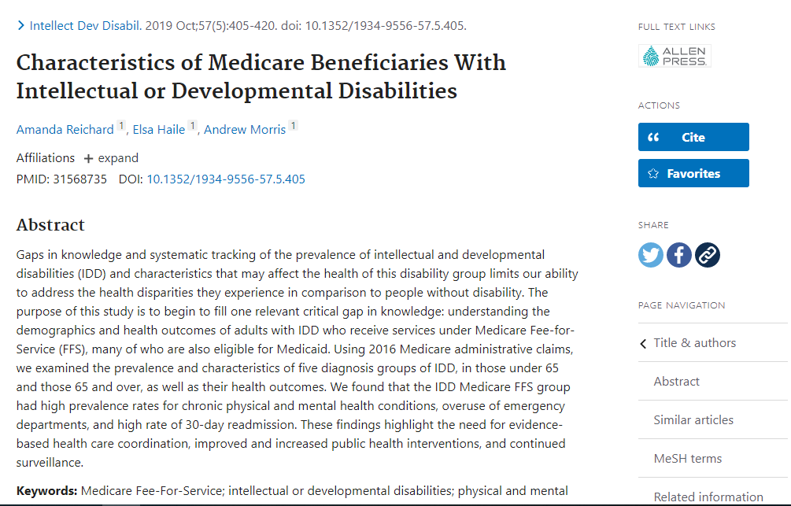
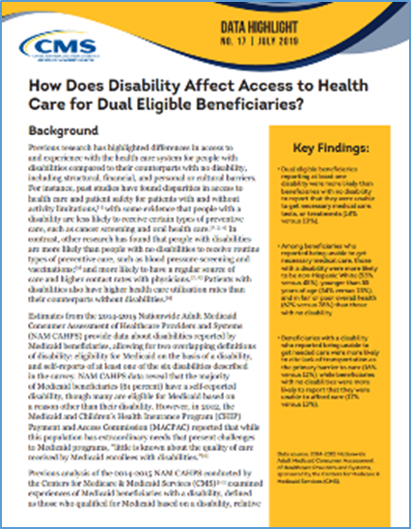
CMS OMH Disability Analysis
Characteristics of Medicare Beneficiaries with Intellectual or Developmental Disabilities – Intellectual and Developmental Disabilities Journal (Oct 2019)
Data Highlight: How Does Disability Affect Access to Health Care for Dual Eligible Beneficiaries? (Jul 2019)

Slide 13
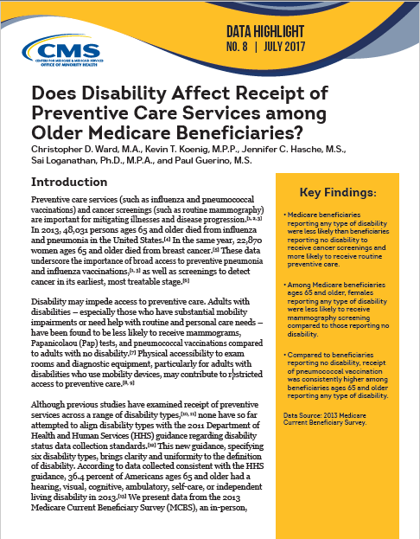
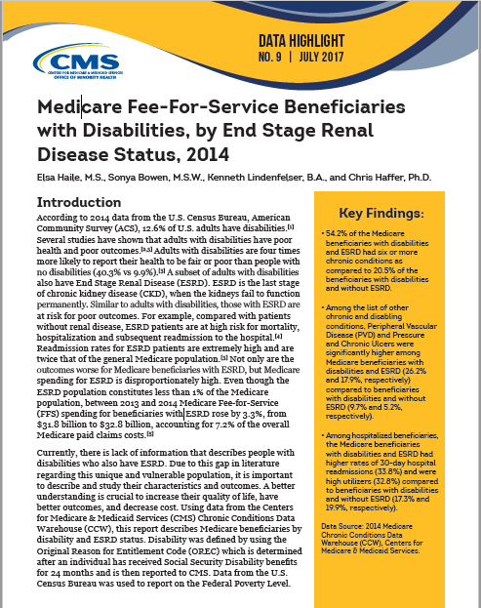
CMS OMH Disability Analysis
Does Disability Affect Receipt of Preventive Care Services Among Older Medicare Beneficiaries? (Jul 2017)
  Medicare Fee-For-Service Beneficiaries with Disabilities, by End Stage Renal Disease Status, 2014 (Jul 2017)

Slide 14
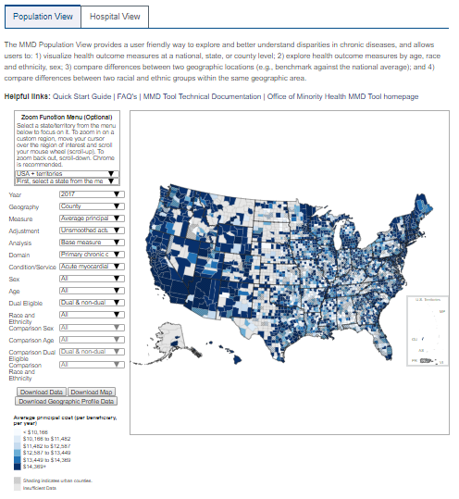
Mapping Medicare Disparities Tool
Launched in March 2016 by CMS OMH, recently updated with 2018 data
Interactive map that allows users to identify areas of disparities between subgroups of Medicare beneficiaries (e.g., racial and ethnic groups) in chronic disease prevalence, health outcomes, spending, and utilization.
Includes 30 Chronic or Potentially Disabling Conditions
Medicare Fee-for-Service data (FFS)
Public use downloadable data and maps
More info:
data.cms.gov/mapping-medicare-disparities

Slide 15
Developing and Disseminating Solutions

Slide 16
CMS Collaboration Example:
Payment for Extended Visits
The 2018 Medicare physician fee schedule offers new provider billing codes for prolonged preventive services:
  Beginning January 1, 2018, practitioners have been able to bill for prolonged preventive services through Healthcare Common Procedure Coding System (HCPCS) G-codes (G0513 and G0514).
  These codes can be billed with eligible Medicare-covered preventive services in 30-minute increments for services that extend beyond the typical time assumed for the services.

Slide 17
Continuous Engagement with
Stakeholders and Partners
CMS OMH continuously engages with stakeholders to inform the work. Important stakeholders include:
  People with Disabilities
  Disability-serving organizations
  Providers and health systems
Gaps in resources are often identified through engagement with stakeholders. Our products are then developed using evidence-based information and best practices. Our products are reviewed before public release and after.
CMS OMH uses a variety of stakeholder communication methods, such as listening sessions and stakeholder calls.
CMS maintains inter-departmental federal partnerships to break down silos and foster collaboration.

Slide 18
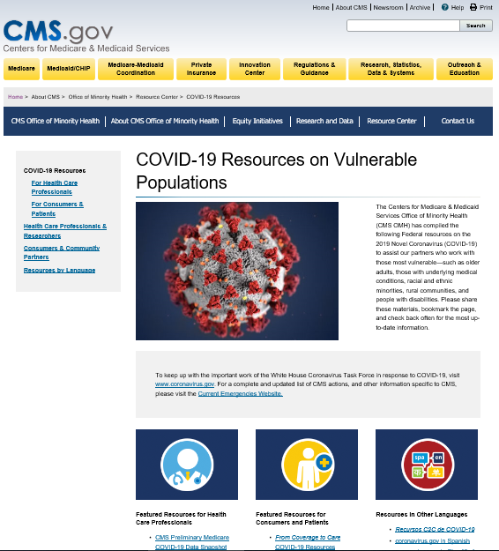
CMS OMH Webpage:
COVID-19 Resources on Vulnerable Populations
Federal resources
  For Providers
  For Consumers
Some resources available in other languages
More info: cms.gov/About-CMS/Agency-Information/
OMH/resource-center/COVID-19-Resources

Slide 19
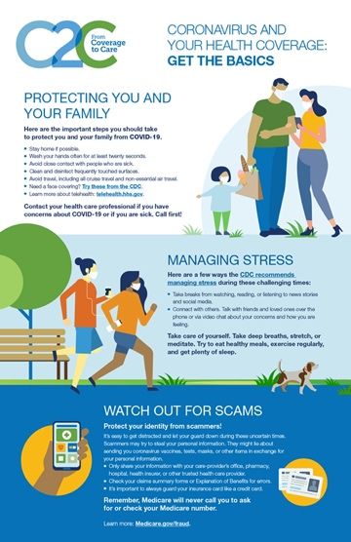
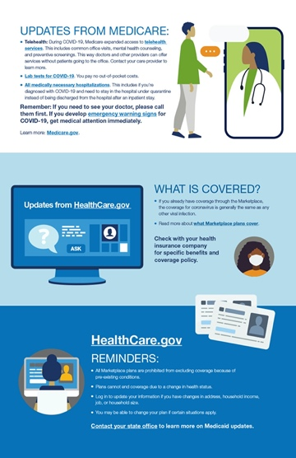
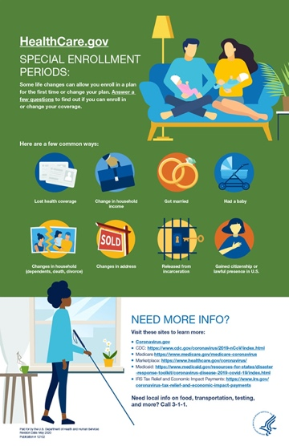
Coronavirus and Your Health Coverage:
Get the Basics
This resource talks about how to protect yourself and your family. It also provides an overview on updates from Medicare, the Marketplace, and other information for consumers looking for information on health coverage and staying healthy during the COVID-19 pandemic
More info:
cms.gov/files/document/c2c-covid-overview.pdf

Slide 20
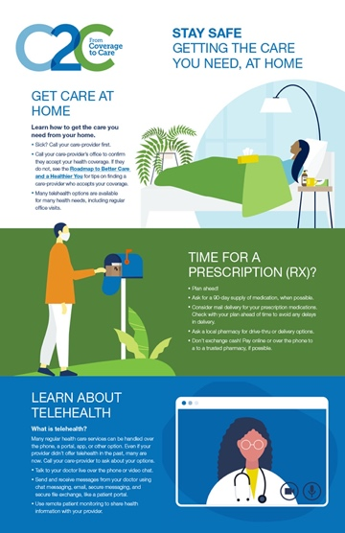
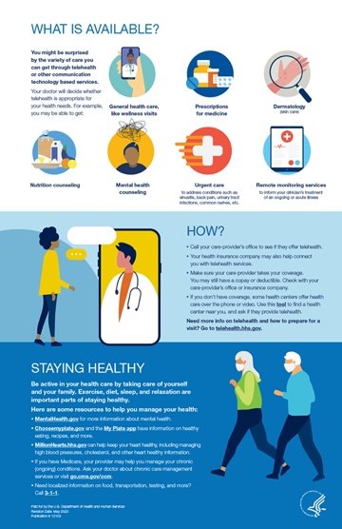
Stay Safe: Get the Care You Need, at Home
Stay Safe: Getting the Care You Need, at Home focuses on how people can stay healthy within their home
This resource gives an overview of telehealth, managing ongoing health conditions, prescriptions, and other tips
More info:
cms.gov/files/document/c2c-covid-care-home.pdf

Slide 21
Provider Resources on Accessibility

Slide 22

Provider Resource – Physical Accessibility
Issue Brief: Increasing Physical Accessibility of Health Care Facilities
Impact of physical accessibility on health outcomes with people with disabilities.
Laws and regulations to promote accessibility
Examples of federal and state-level efforts to increase accessibility

Slide 23

Provider Resource – Physical Accessibility
Modernizing Health Care to Improve Physical Accessibility: Resource Inventory
Standards and guidance on physical accessibility
Assessment tools
Tips and resources to support improvements

Slide 24
Other Relevant Provider Resources

Slide 25


Provider Resources - Diabetes
Diabetes Management: Directory of Provider Resources
Aims to equip primary care teams with tools to manage diabetes and also ensure patients with more complex needs are appropriately referred to specialists
A Culturally and Linguistically Tailored Type 2 Diabetes Prevention Resources Inventory
Features a catalog of evidence-based approaches to diabetes prevention tailored for vulnerable populations

Slide 26

Provider Resource – Chronic Kidney Disease
Chronic Kidney Disease Disparities: Educational Guide for Primary Care
Approaches to Identifying Chronic Kidney Disease
Approaches to Treatment and Monitoring of CKD Progression
Approaches to Centering Care on the Patient

Slide 27
Provider Resource –
Reducing Disparities in Readmissions
Guide to Reducing Disparities in Readmissions
Hospitals have requested additional guidance on how to implement both system-wide redesign as well as specific efforts on preventing readmissions among minority populations.
The goals of the guide are to provide:
• An overview of key issues related to disparities in readmissions
• A set of activities that can help hospital leaders address readmissions in this population
• Strategies aimed at reducing readmissions in diverse populations

Slide 28


Provider Resources –
Language and Communication Access
  Guide on developing a Language Access Plan (LAP)
  Identifies ways that providers can assess their programs and develop language access plans to ensure persons with limited English proficiency have meaningful access to their programs.
Building an Organizational Response to Health Disparities: Five Pioneers from the Field
Case studies with five private-sector health care organizations to understand how they identify and address health disparities in the communities they serve.

Slide 29

Provider Resource – National CLAS Standards
A Practical Guide to Implementing the National CLAS Standards
CLAS stands for Culturally and Linguistically Appropriate Services.
This guide is to enable organizations to implement the National CLAS Standards and improve health equity.
It provides practical tools and examples of CLAS, in addition to efforts to implement the National CLAS Standards that can be adapted for use by health care organizations.

Slide 30
Consumer Resources

Slide 31

Consumer Resource – For People with Disabilities
Getting the Care you Need: A Guide for People with Disabilities
Information on rights
How to work with a provider to get the care you need
Contact information to file a complaint
Checklists to prepare before, during and after appointments
Available in Spanish, Mandarin, Arabic, Vietnamese, Korean, and Russian.
To request physical braille copy, contact healthequityTA@cms.hhs.gov.

Slide 32




Consumer and Provider Disability Videos
Two Video Vignettes:
Navigating Health Care with a Disability: Our Stories, A Focus on the Provider
Navigating Health Care with a Disability: Our Stories, A Focus on People with Disabilities

Slide 33
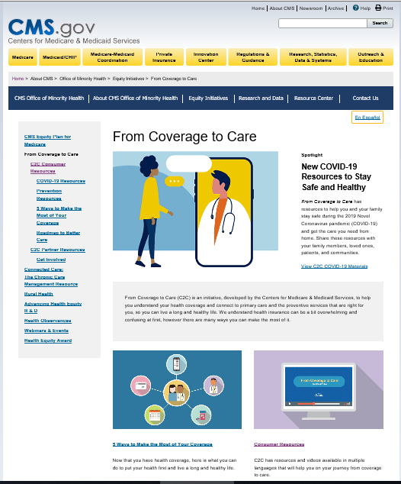
Consumer Resources – From Coverage to Care
From Coverage to Care (C2C)
CMS initiative to help consumers understand their health coverage and connect to primary care and the preventive services that are right for them.
Variety of consumer resources that could be useful to people with disabilities accessing care.
More info: cms.gov/About-CMS/Agency-Information/OMH/equity-initiatives/from-coverage-to-care

Slide 34
Implementing Sustainable Actions

Slide 35
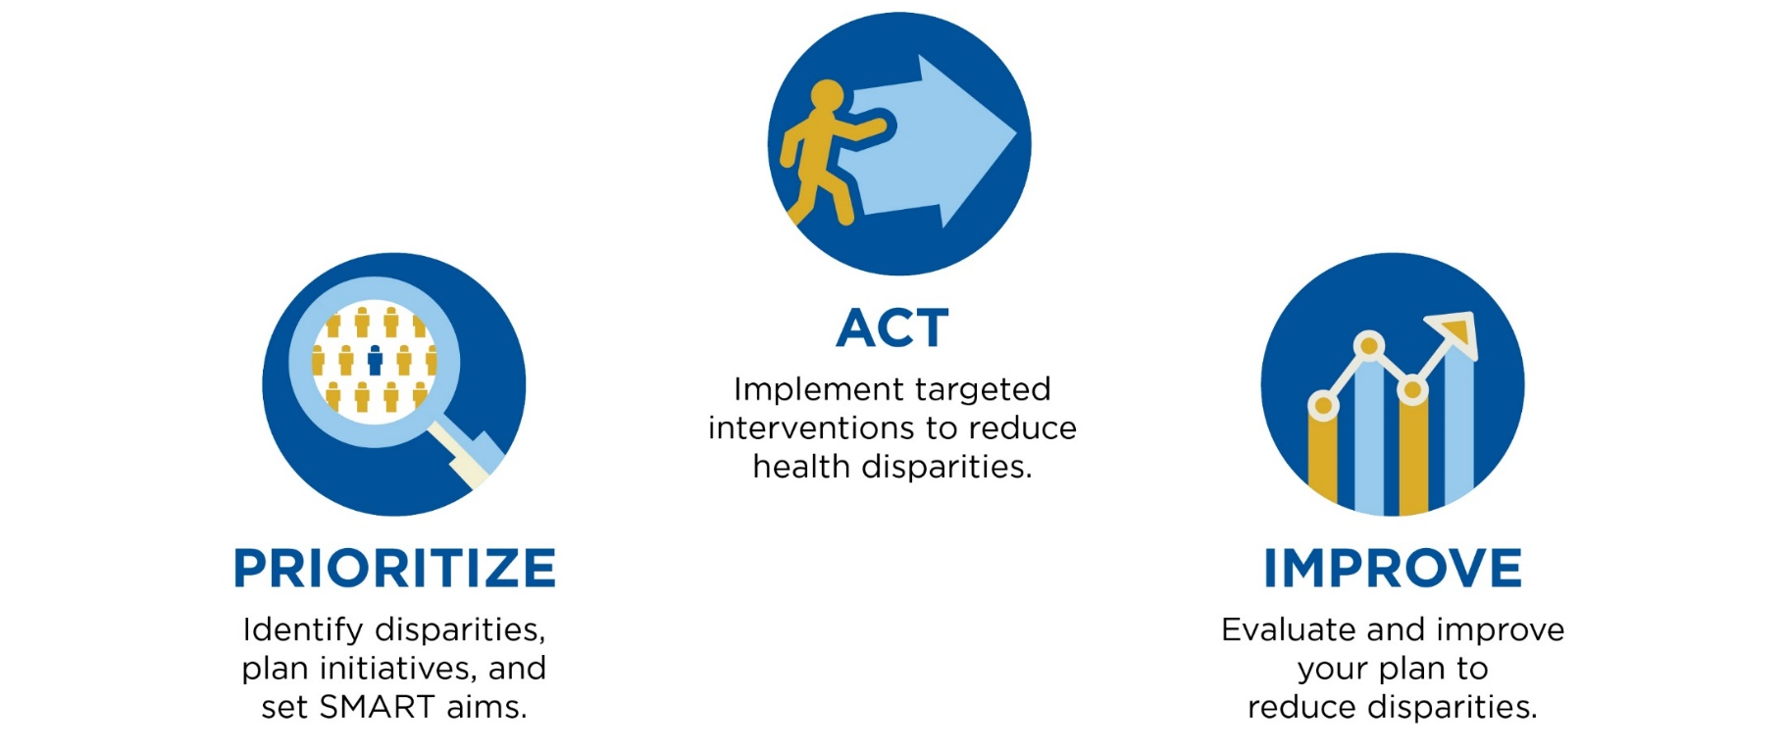
Health Equity Technical Assistance
Disparities Impact Statement: Learn how to identify, prioritize, and take action on health disparities. Personalized technical assistance focused on strengthening your quality improvement program through a series of consultations from subject matter experts
More info:
HealthEquityTA@cms.hhs.gov

Slide 36
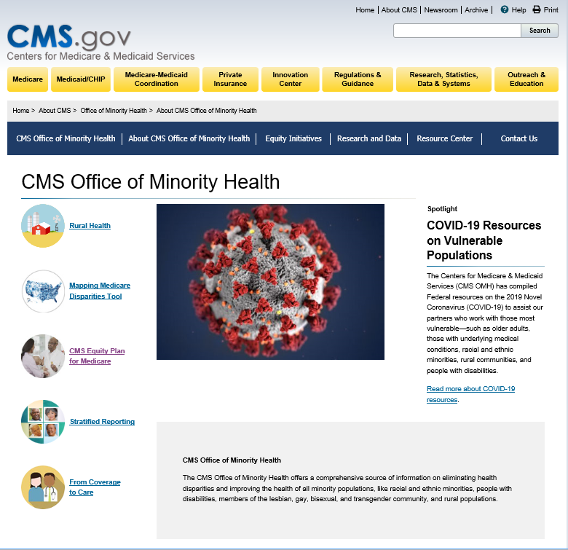
For More Information: go.cms.gov/omh

Slide 37
Medicare-Medicaid Coordination Office:
Promoting Access to Seamless, High Quality Care for People Dually Enrolled in Medicare & Medicaid

Slide 38
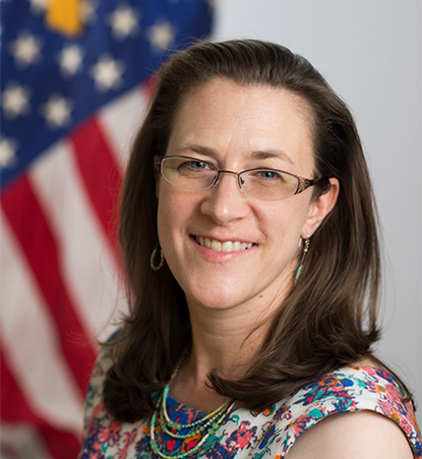
Sonya Bowen, MSW
Health Care Analyst
Medicare-Medicaid Coordination Office
Centers for Medicare & Medicaid Services

Slide 39
About the Medicare-Medicaid Coordination Office
The Federal Coordinated Health Care Office (Medicare-Medicaid Coordination Office or MMCO)
    serves people who are dually enrolled in both Medicare and Medicaid, also known as dual eligible individuals or Medicare-Medicaid enrollees,
    works across federal agencies, states, and stakeholders to align and coordinate benefits between the two programs effectively and efficiently, and
    partners with states to develop new care models and improve the way Medicare-Medicaid enrollees receive health care.
  MMCO goal is to make sure Medicare-Medicaid enrollees have full access to seamless, high quality health care and to make the system as cost effective as possible.

Slide 40
Disability-Competent Care (DCC)
Disability-Competent Care is a participant-centered model:
Delivered by an interdisciplinary care team (IDT) focused on achieving and supporting the individual’s maximum function
Intended to maintain health, wellness, and life in the community as the participant chooses
Recognizing and treating each individual as an individual, not a diagnosis or condition
Structured to respond to the participant’s physical and clinical needs while considering his or her emotional, social, intellectual, and spiritual needs

Slide 41
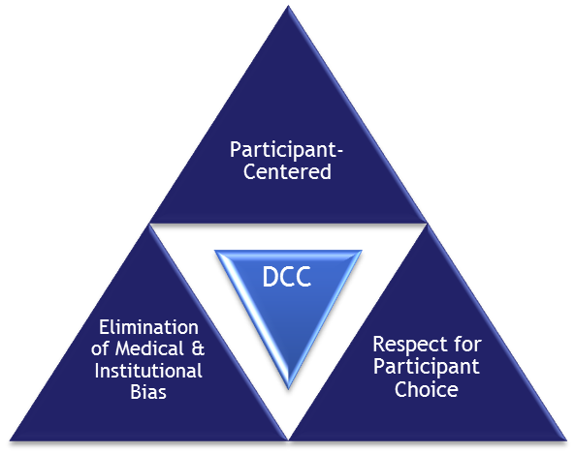
Disability-Competent Care (DCC)
The DCC Model is comprised of
three core values:
1. Participant-centered
    Participant’s choices, preferences, and goals provide a foundation for his or her individualized plan of care.
2. Respect for participant choice and dignity of risk
    Inherent in participant-centered planning of care goals and needs is the concept of the dignity of risk, which honors and respects the participant’s choices even if they are inconsistent with healthcare recommendations.
    3. Elimination of medical and institutional bias
    Medical and institutional bias often impedes providers from addressing the whole individual, including his or her unique abilities, limitations, and preferences for social and community participation.

Slide 42
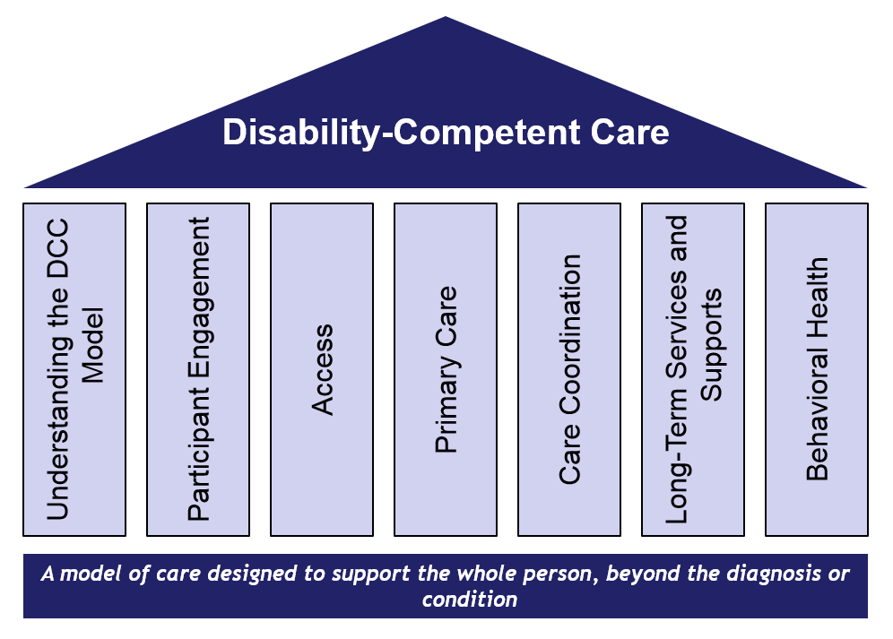
DCC Pillars
The DCC pillars are comprised of seven functional areas. Each pillar can stand alone, and together, they form the model’s foundational structure.

Slide 43
Disability-Competent Care Resources: DCCAT
Disability-Competent Care Self-Assessment Tool (DCCAT)
Designed to assist health plans and health systems in evaluating their ability to meet the needs of adults with disabilities or functional limitations
Used by health plans and health systems to help them identify strategic opportunities for improving their disability competency
Available to download as a PDF file, with an Excel scoring sheet (DCCAT Evaluation Results Form)
Offers User Guide (PDF) to provide step-by-step tutorial on using the tool and interpreting results
Available from: https://www.resourcesforintegratedcare.com/physical_disability/dcc/tools/self_assessment

Slide 44
Disability-Competent Care Resources: DCC-START
Disability-Competent Care Self-paced Training Assessment Review Tool
(DCC-START)
  Intended to assist health plans, health systems, and health care provider organizations in strengthening their efforts to provide integrated, coordinated care to their members with disabilities
  Assesses organization’s DCC training materials and identifies opportunities for enhancement
  Complements the Disability-Competent Care Self-Assessment Tool (DCCAT) used by health plans and organizations to evaluate their DCC capabilities
  Available from: https://www.resourcesforintegratedcare.com/disabilitycompetentcare/tools/2017/dcc_start

Slide 45
Disability-Competent Care:
Preparing the Health Care Workforce
“A call to action: Preparing a disability-competent health care workforce”
  New commentary developed through partnership between RIC and the Ohio Disability and Health Program and recently published in the Disability and Health Journal.
  Describes gaps in health education and continuing education curricula, document barriers to progress, and demonstrate how the DCC model and The Ohio State’s Disability Competencies Project offer a clear roadmap to effect systemic change in the health care workforce.
  Available from: https://doi.org/10.1016/j.dhjo.2020.100941

Slide 46
My Health, My Life Toolkit
Toolkit for individuals with intellectual and developmental disabilities (I/DD), their family member(s) or guardian(s) and their provider support team to:
  Improve communication when entering and leaving the hospital or care setting; and
  Build or strengthen relationships between medical providers and the individual and their family member(s) or guardian(s).
  Available from: https://www.resourcesforintegratedcare.com/IDD/Care_Integration/Toolkit/My_Health_My_Life
  (in both English and Spanish)

Slide 47
Supporting Better Communication for Better Care
Using a person-centered approach is essential for health plans and providers when communicating with and about the individuals they serve.
  Person-Centered Language Tip Sheet available from https://www.resourcesforintegratedcare.com/sites/default/files/Using_Person_Centered_Language_Tip_Sheet.pdf
  Person-Centered Language At a Glance printable reference available from https://www.resourcesforintegratedcare.com/sites/default/files/Using_Person_Centered_Language_Graphic.pdf

Slide 48
Additional RIC Resources
Resources for Integrated Care (RIC) includes technical assistance for providers serving Medicare-Medicaid enrollees available from: https://resourcesforintegratedcare.com/
DCC resources, including webinars, self-assessment tools, first-person stories, and tip sheets available from: https://www.resourcesforintegratedcare.com/concepts/disability-competent-care
Provider resources on understanding health and support needs of people with I/DD and improving coordination of offered services and supports, available from: https://www.resourcesforintegratedcare.com/concepts/intellectual-developmental-disabilities

Slide 49

Stay Connected to RIC
Follow RIC by e-mail and on social media
  Sign up for the Listserv: https://www.resourcesforintegratedcare.com/email-updates
  Follow RIC on twitter: @Integrate_Care
  Reach out with suggestions and feedback: RIC@Lewin.com

Slide 50
Q&A with Panelists
Karen Gentile
CMS Office of Minority Health
karen.gentile@cms.hhs.gov
Sonya Bowen
Medicare-Medicaid Coordination Office
sonya.bowen@cms.hhs.gov

